Slide 1
Become a Windows 7 Power User
Richard Corzo
March 1, 2011

Slide 2
Desktop Customization
Start menu, taskbar, gadgets

Slide 3
Windows 7 Themes
Desktop backgrounds
Window color
Sounds
Screen saver
Pick one…
Right click desktop
Select Personalize
Choose an Aero Theme, or click Get more themes online

Slide 4
Your Desktop—
Is almost always covered up.
It’s icons are rearranged upon changing resolution.
Doesn’t show a folder hierarchy.
So…
It’s not a good Start menu
It’s not a good place to store files

Slide 5
Quit the habit…
Right click the desktop
Select View
Uncheck Show desktop icons
Instead…
Use the Start menu, taskbar, or keyboard shortcuts for starting programs
Use your home (a.k.a. personal) folder to store files

Slide 6
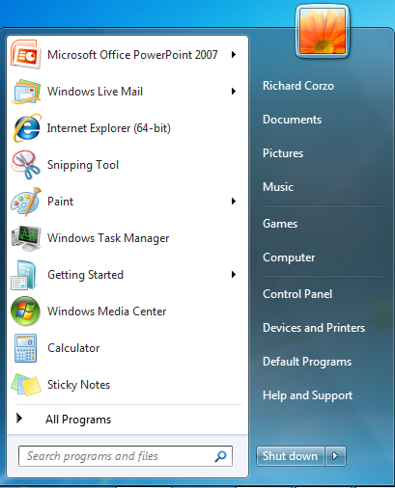
Start menu
Left side has program shortcuts
Frequently used and pinned programs
All Programs leads to traditional hierarchical Start menu
Back goes back to recent list
Right side has places: personal folder, Computer, Control Panel
Search box

Slide 7
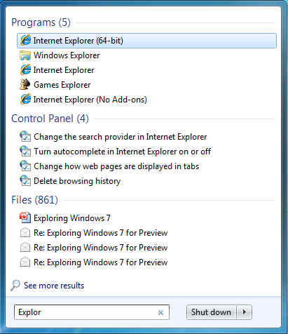
Search box
Find programs, files
Locations and file types searched are controlled by Indexing Options in Control Panel

Slide 8
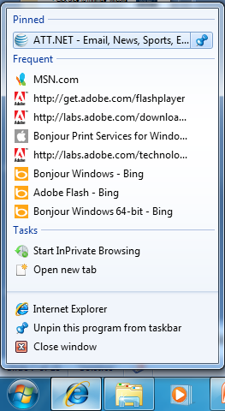
Jump lists
Recent documents or websites, or Tasks
To access, right click taskbar icon, or click triangle next to Start menu shortcut
Pin or unpin recent items

Slide 9
Taskbar…
Combines open tasks and XP’s Quick Launch bar.
Pin your most needed programs to the taskbar (or Start menu) to replace Quick Launch bar
Labels next to icons of open tasks are optional
Use Aero Peek at right end of taskbar to reveal desktop
Click once to minimize windows
Click again to restore windows

Slide 10
Customize the Taskbar
Right click and select Properties…
Hide labels or use small icons to make room for more open tasks
Auto-hide taskbar to make more vertical room on widescreen displays
Unlock taskbar temporarily to change position of pinned programs

Slide 11
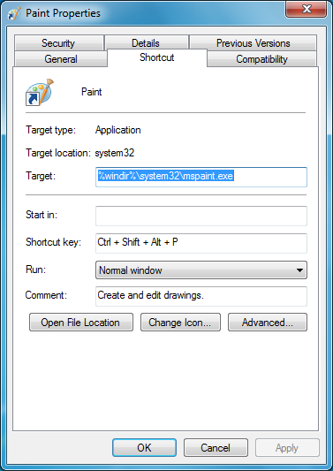
Keyboard shortcuts
Right click Start menu shortcut
Select Properties
Click in Shortcut key box and press desired shortcut keys
To avoid conflict with application shortcut key, try Ctrl + Shift + Alt + letter

Slide 12
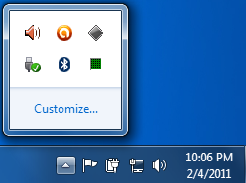
Notification area
Formerly known as System Tray.
Hidden icons now live in a usually hidden window.
Choose behavior: Show/Hide icon and notifications, or Only show notifications.

Slide 13
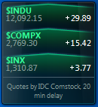
Gadgets for the Desktop
Built-in weather, clock, calendar, etc.
Good third party gadgets may be hard to find...
These work for me:
Multi Meter (Dual Core)
Stocks for Windows 7
PackageMapping.com—package tracking
Pandora—from Pandora, 64-bit requires 64-bit Flash
Set opacity on gadgets to reveal background

Slide 14
Applications in Windows 7
What’s missing, installing new, 64-bit

Slide 15
Aero Snap
To maximize window height, drag window border to top or bottom edge of screen
To compare two documents, drag one to right and one to left edge of screen
Nudge window to snap it back into its former shape

Slide 16
Missing from Windows 7…
Mail program (Outlook Express/Windows Mail)
Calendar (Vista had Windows Calendar)
Address book (Vista had Windows Contacts)
Windows Photo Gallery
Windows Movie Maker

Slide 17
Windows Live Essentials 2011
Download from http://explore.live.com/windows-live-essentials to get Windows Live—
Messenger
Mail (including Calendar and Contacts)
Photo Gallery
Movie Maker
Mesh (sync folders, IE favorites)

Slide 18
Installing Applications
Be discriminate on what you install
Don’t use express/standard install
Pay attention to options:

Slide 19
64-bit vs. 32-bit
Windows 7 64-bit requires at least 2GB of RAM
With 64-bit Windows use 64-bit programs when available
64-bit Windows 7 has 32-bit and 64-bit versions of Internet Explorer
Use Internet Explorer (64-bit) to find 64-bit programs to download, for example Java, iTunes

Slide 20
Organizing and Sharing Documents
Libraries, Homegroups

Slide 21
Libraries
Collect folders of the same type from different locations:
Documents
Music
Pictures
Videos
Define your own libraries, for example, Downloads
Select folder and click Include in library > Create new library
Libraries show up in Windows Explorer windows and open/save dialogs

Slide 22
Networking
Network and Sharing Center
Home vs. Work network—
Both are private networks
Only Home network can create or join a homegroup
Homegroup —
A way to share libraries (instead of individual folders) with just a common homegroup password

Slide 23
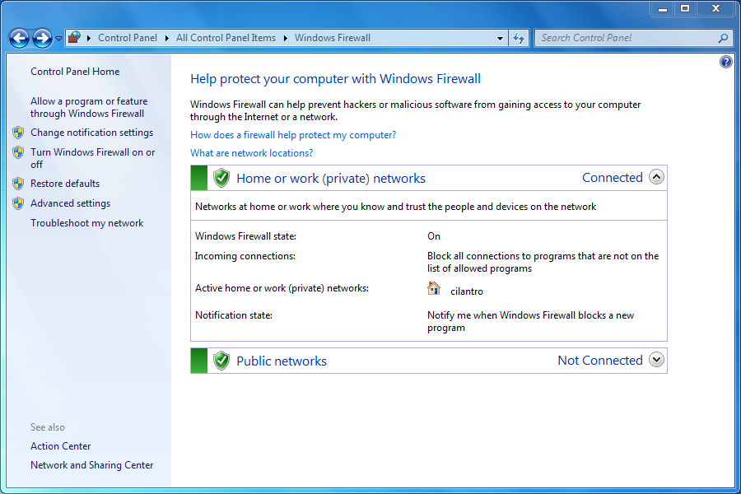
Windows Firewall
Home/work versus public networks

Slide 24
Maintenance FEatures
Backup and Restore, Performance, Command Prompt

Slide 25
Control Panel
Windows XP
Accessibility Options
Add Hardware, Bluetooth Devices, Game Controllers, Portable Media Devices, Printers and Faxes, Scanners and Cameras
Add or Remove Programs
Automatic Updates
Display
Network Connections
Security Center
Windows 7
Ease of Access Center
Devices and Printers
Default Programs, Programs and Features
Windows Update
Color Management, Display, Personalization
Network and Sharing Center
Action Center

Slide 26
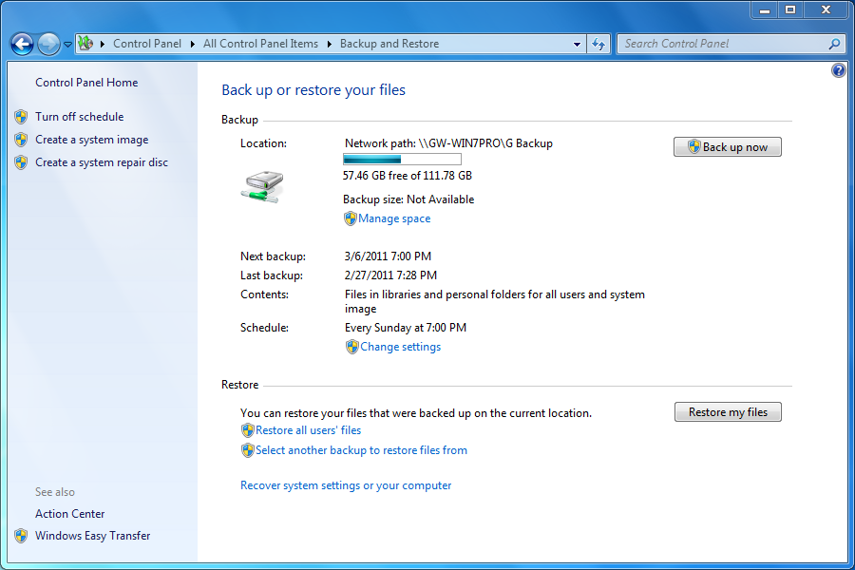
Backup and Restore
Included in all editions
Can back up to network on Windows 7 Professional and above (but test this!)

Slide 27
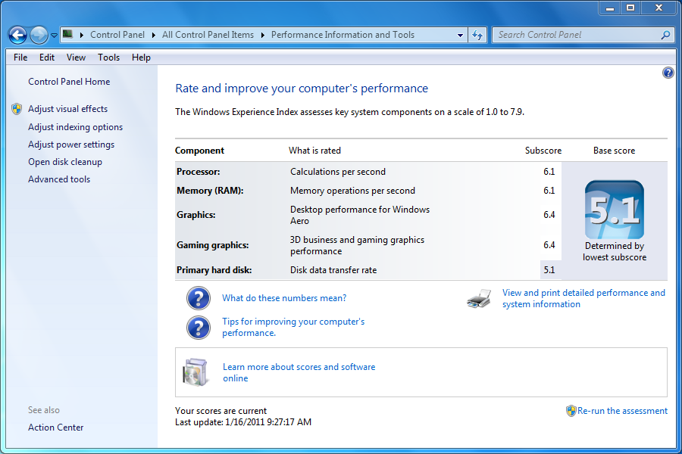
Performance
Performance Information and Tools

Slide 28
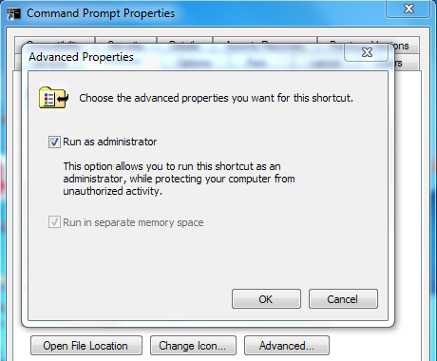
Command Prompt
To run some commands you will need to Run as administrator
Permanent fix:
Right click Command
Prompt shortcut to
select Properties
Click Advanced…
Check Run as
administrator

